Slide 1

Research services
Est 2016

Slide 2



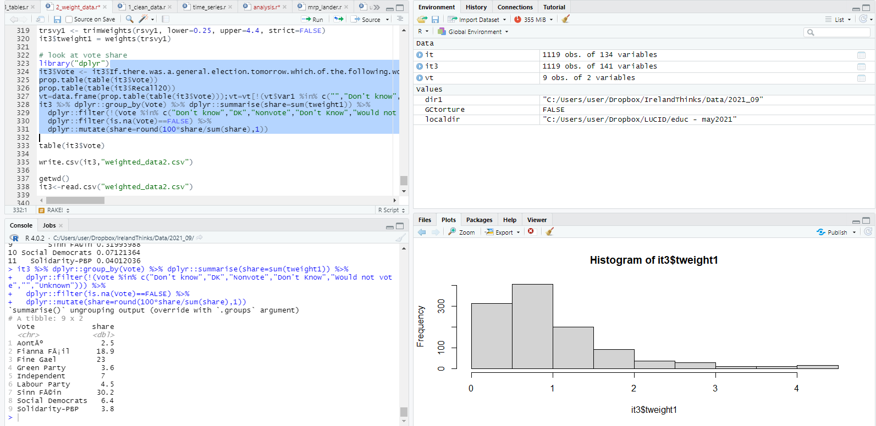
What is our polling methodology?
Stage 1: Where do your participants come from?
Using random digit dialling and online ads Ireland Thinks has built a panel of approximately 25,000 people, the equivalent of Thomond Park Stadium who are happy to participate in our monthly polls. This is continually topped up through advertisements targeting specific demographics as and when they are needed.
Stage 2: So, these are surely highly engaged people, how are they representative?
No. For our polls our algorithm chooses 5,000 specific individuals to take part. They are chosen on the basis of their demographics and behaviours (age, gender, religious adherence, educational attainment, past voting behaviour, political interest etc.) to ensure that they are an exact replica of the census and within that, the most recent general election exit poll. Note: This algorithm minimises design-effect error, meaning that cross-tabs tend to be more reliable.
Stage 3: So how do you contact them? And how do you know the right person is answering?
Participants are sent an SMS message with a unique URL to participate in the opinion poll. Over 90% of the population own a smartphone, far fewer are at-home during the day (for face to face), use land-lines, or respond to unsolicited calls, or emails. Any duplicated entries from the same URL are deleted as is the user. Respondents must also match the data we have on record for the respondent.
Note: Here we minimise social desirability bias and non-response bias.
Stage 4: How long does it take? How do I know they’re responding accurately?
We get over 1,000 responses within 3 hours, rising thereafter. The respondents experience is central to ensuring that we have quality responses. The polls are short, enjoyable and participants are rewarded by selecting the charity that we will donate to and results are published in a national newspaper. The responses are weighted to ensure that they are exactly representative of the population in terms of the same demographics above.
Note: Finally we minimise respondent error and sampling error.

Slide 3
This poll was conducted from 5th to 18th July 2023
The sample size was 1,004

Slide 4
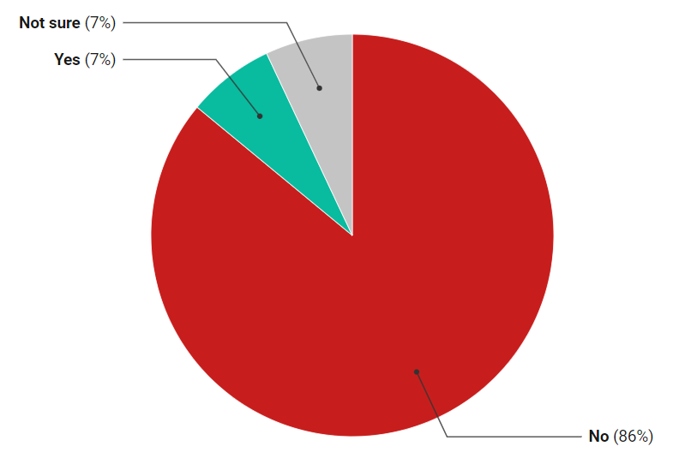
Q1. In the past four weeks have you experienced symptoms of long Covid following a period of infection with Covid 19?

Slide 5
Q1. In the past four weeks have you experienced symptoms of long Covid following a period of infection with Covid 19?

Slide 6
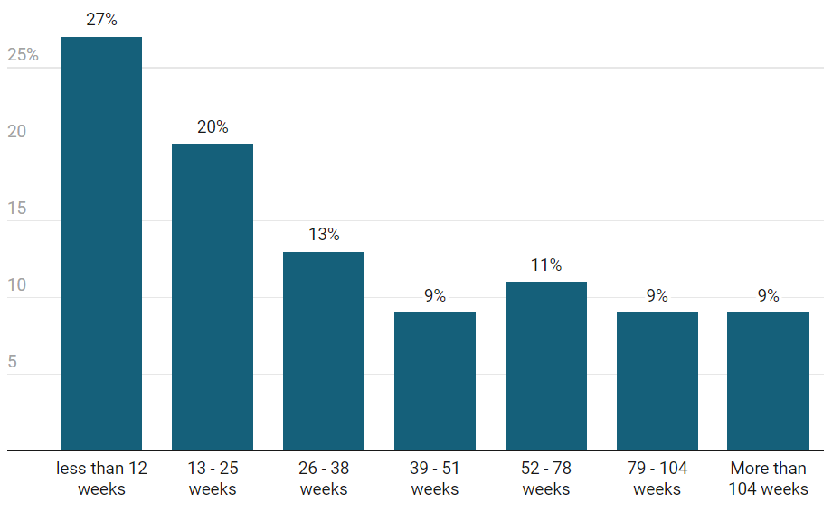
Q2. [If yes] How long ago did these symptoms start?

Slide 7
Q2. [If yes] How long ago did these symptoms start?
Apply a lot of caution on these numbers, sample sizes are very low

Slide 8
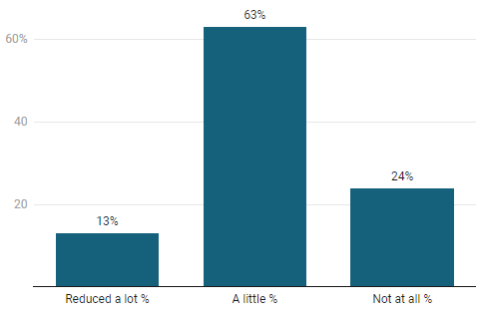
Q3. Have your long-covid symptoms reduced your ability to conduct your daily activities?
[12+ Week Long Covid]

Slide 9
Q3. Have your long-covid symptoms reduce your ability to conduct your daily activities?
Apply a lot of caution on these numbers, sample sizes are very low

Slide 10
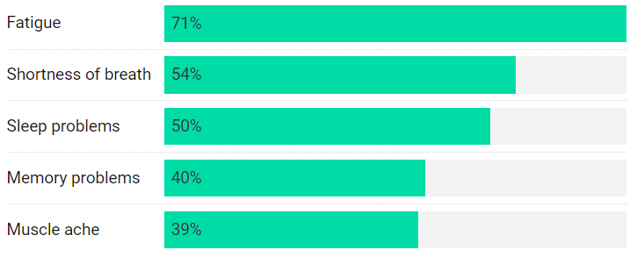
Q4. What long Covid symptoms have you experienced?
(Select all that apply)
Only asked of relevant respondents

Slide 11
Q4 What long Covid symptoms have you experienced? (Select all that apply)
Apply a lot of caution on these numbers, sample sizes are very low

Slide 12
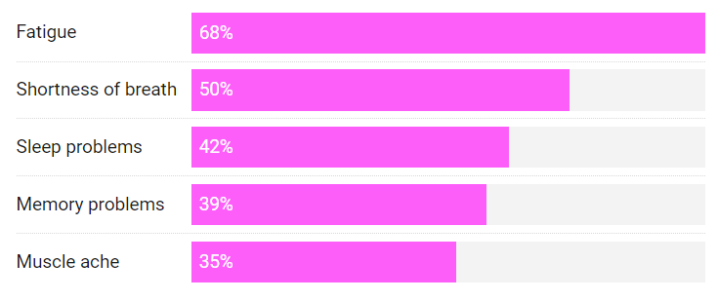
Q5. What long Covid symptoms have you experienced for 12 weeks or more?
(Select all that apply)
Only asked of relevant respondents

Slide 13
Q4 What long-Covid symptoms have you experienced for 12 weeks or more? (Select all that apply)
Apply a lot of caution on these numbers, sample sizes are very low

Slide 14
Research services
Est 2016

